Slide 1

, Helen Jin

Slide 2

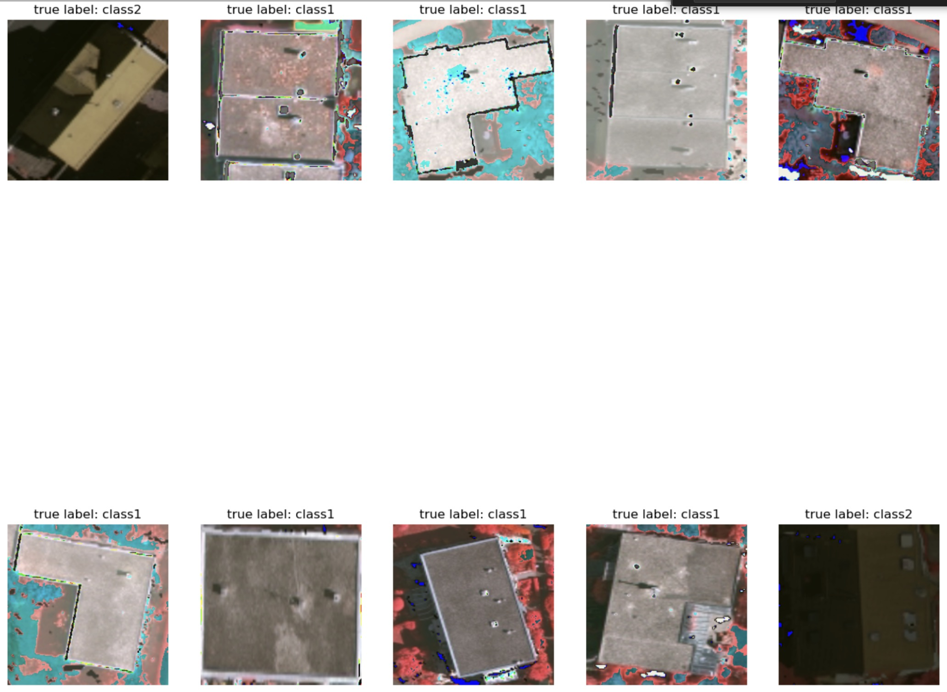
GitHub README
​​https://github.com/lornalyu/QTM-Project

Slide 3
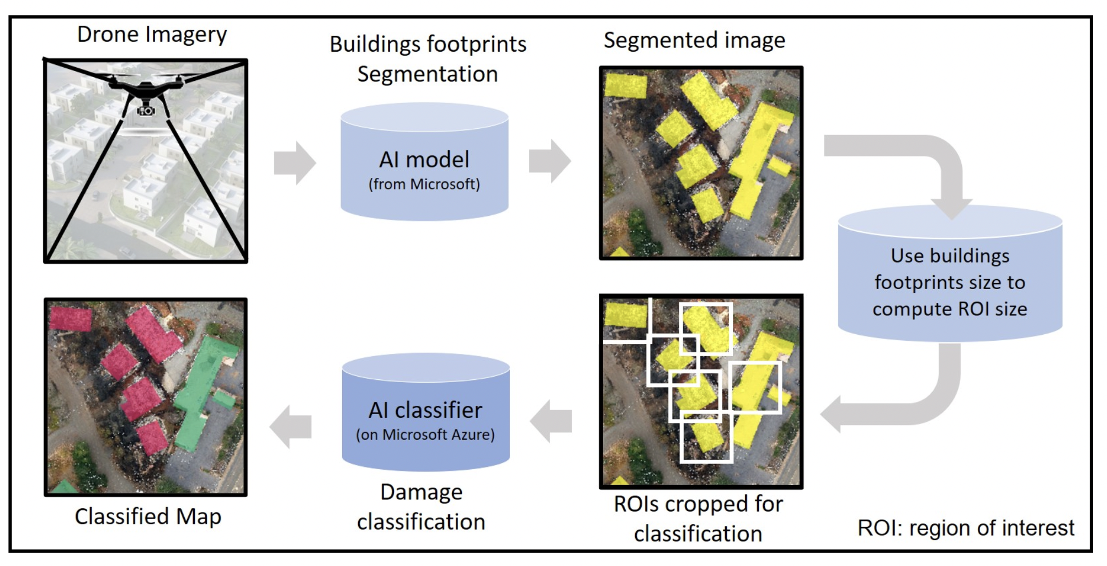
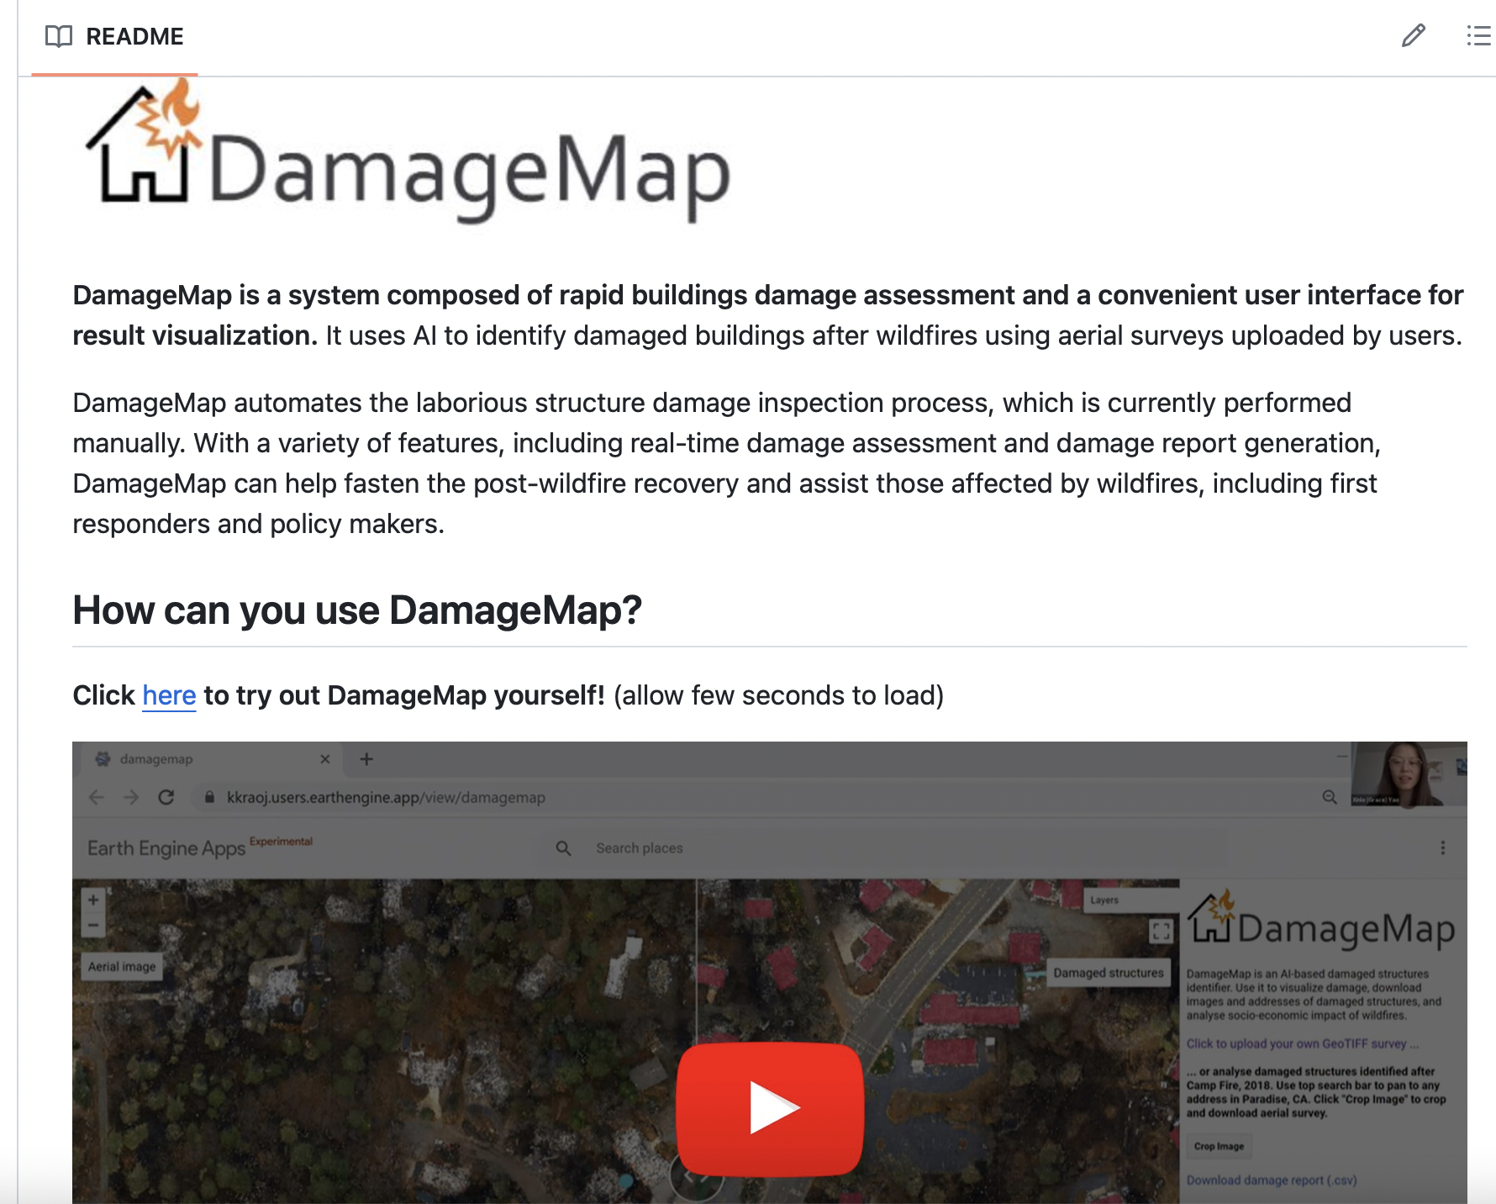
Where we get CNN model from
(Damaged_structures_detector)
https://github.com/kkraoj/damaged_structures_detector

Slide 4
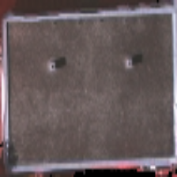
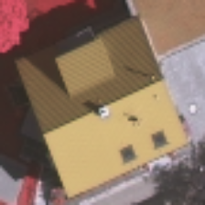
Model and Datase
Current Task: Roof Type Classification
Number of Classes: 2 (balanced)
Data Set:
Roof Types DataSet (labeled)
Train: 200, Validation: 24, (Test: 32)
Training criterion: Cross Entropy Loss
Epoch: 20
Batch Size: 10
Flat
Gables
Model Name: Resnet (Residual Network)
https://github.com/loosgagnet/Building-detection-and-roof-type-recognition
Layers: 18 (Resnet18)

Slide 5
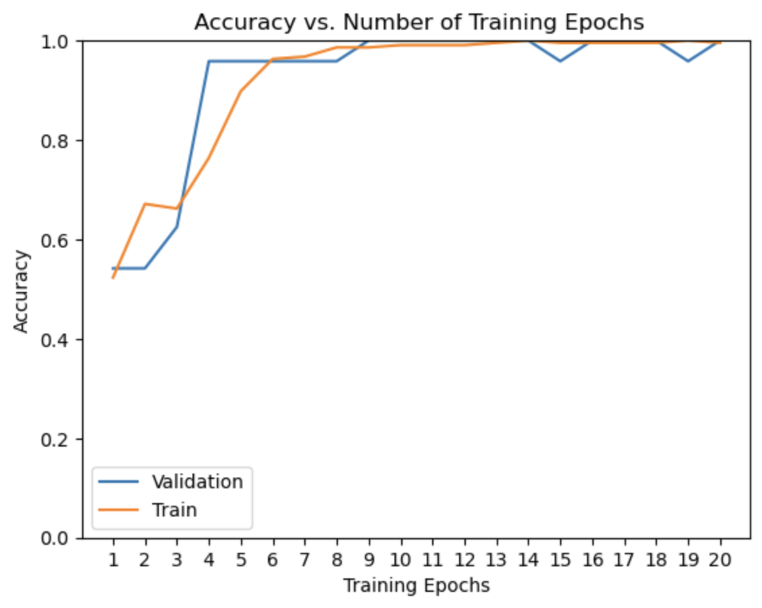
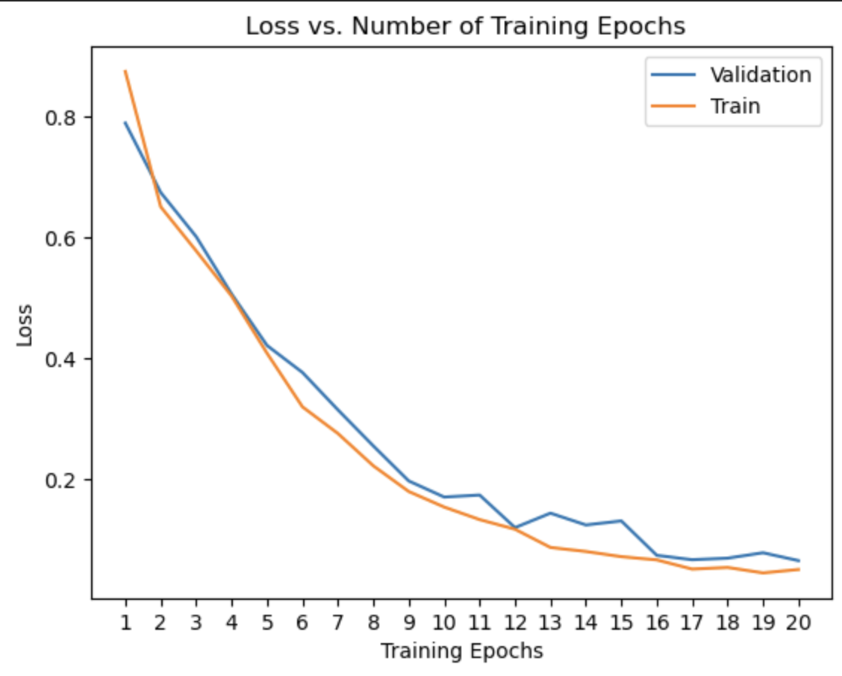
Result

Slide 6
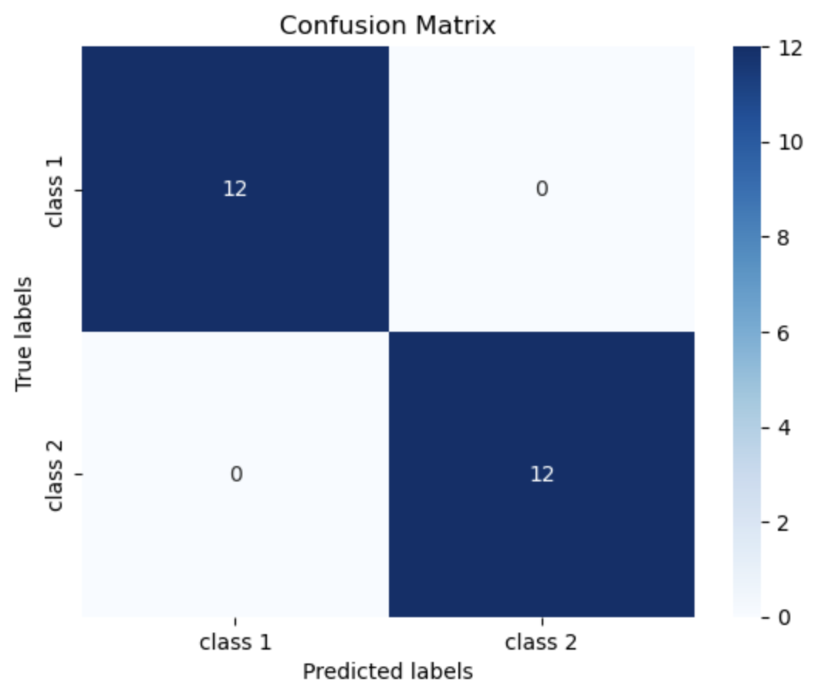
Result

Slide 7

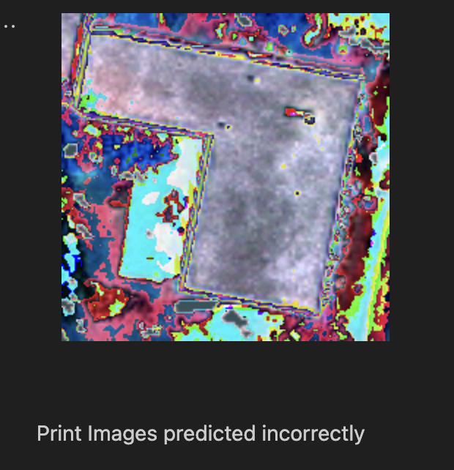
Other Cool Graphs:

